Slide 1
18CSC304J COMPILER DESIGN
UNIT 4
SESSIONS 6(b) & 7(a)

Slide 2
Topics that will be covered
Basic Blocks & Flow Graphs
Next Use Information

Slide 3
BASIC BLOCKS & FLOW GRAPHS

Slide 4
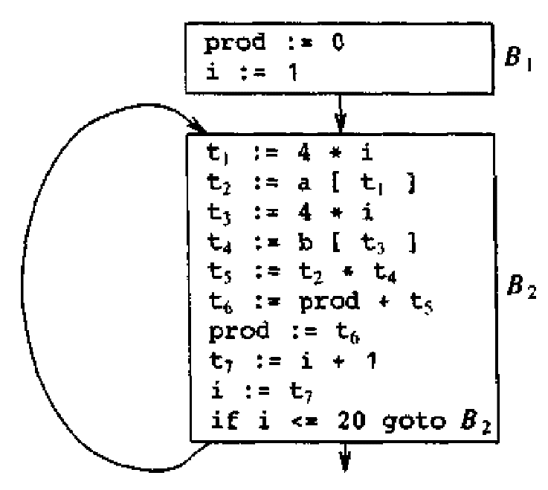
Basic Blocks & Flow Graphs
A graph representation of three-address statements, called a flow graph is useful for understanding code-generation algorithms
Nodes in the flow graph represent computations and the edges represent the flow of control

Slide 5
Basic Blocks
A basic block is a sequence of consecutive statements in which flow of control enters at the beginning and leaves at the end without halt or possibility of branching except at the end.
The following three-address statements forms a basic block
t1 := a * a
t2 := a * b
t3 := 2 * t2
t4 := t1 + t3
t5 := b * b
t6 := t4 + t5
A three-address statement x := y + z is said to define x and to use or reference y and z
A name in a basic block is said to be live at a given point if its value is used after that point in the program, perhaps in another basic block

Slide 6
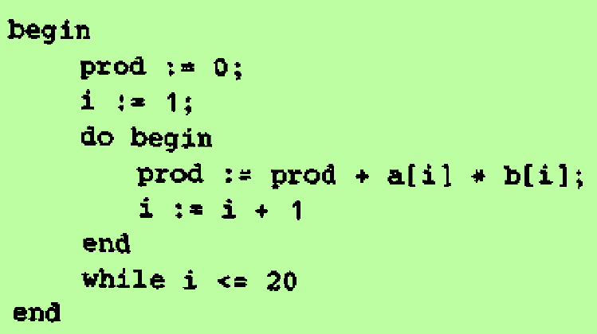
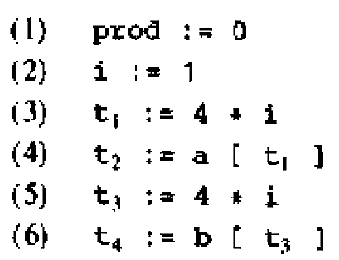
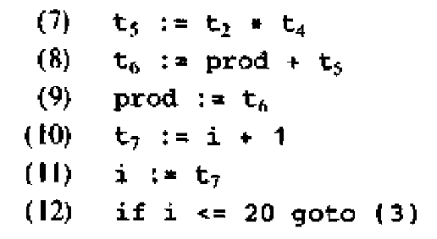
Algorithm: Partition a sequence of three-address statements into basic blocks
Determine the set of leaders, the first statement of basic blocks, using the rules
The first statement is a leader
Any statement that is a target of a conditional or unconditional goto is a leader
Any statement that immediately follows a goto or conditional goto statement is a leader
For each leader, its basic block consists of the leader and all statements upto but not including the next leader or the end of the program
Example:
Source Code: Three address code:

Slide 7
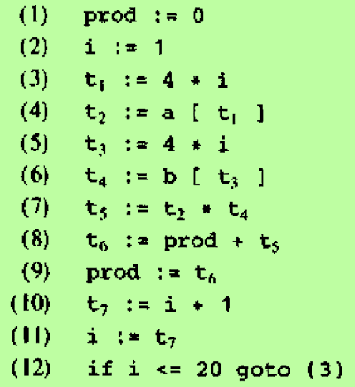
Basic Blocks
Statement (1) is a leader by rule (i)
Statement (3) is a leader by rule (ii)
Statement following (12) is a leader by rule (iii)
The basic blocks are
First basic block
Second basic block

Slide 8
Transformation on Basic Blocks
A basic block computes a set of expressions
Two basic blocks are said to be equivalent if they compute the same set of expressions
A number of transformations can be applied to a basic block without changing the set of expressions computed by the block
There are two types of transformations:
Structure-preserving transformations
Algebraic transformation

Slide 9
Structure Preserving Transformations
Common subexpression Elimination
Consider the basic block
a := b + c
b := a – d
c := b + c
d := a – d
The second and fourth statements compute the same expression.
So we can change the basic block as follows:
a := b + c
b := a – d
c := b + c
d := b

Slide 10
Structure Preserving Transformations – cont..
Dead-code Elimination
Suppose x is dead, that is, never subsequently used, at the point where the statement x := y + z appears in a basic block
Then this statement may be safely removed without changing the value of the basic block

Slide 11
Structure Preserving Transformations – cont..
3. Renaming temporary variables
Suppose we have a statement t := b + c where t is a temporary
We can change this statement as u := b + c where u is a new temporary, and change all uses of t to u
A basic block can be transformed into an equivalent block by renaming each temporary variable
Such a basic block is called a normal-form block

Slide 12
Structure Preserving Transformations – cont..
4. Interchange of Statements
If we have a block with the two adjacent statements
t1 := b + c
t2 := x + y
Then we can interchange the two statements without affecting the value of the block, if an only if
Neither x nor y is t1
Neither b nor c is t2

Slide 13
Algebraic Transformations
Statements such as
x := x + 0
or x := x * 1
can be eliminated from a basic block without changing the set of expressions it computes
The exponentiation operator in the statements
x := y ** 2
can be replaced by the cheaper but equivalent statement
x := y * y
1
2

Slide 14
Flow Graphs
A flow graph is a directed graph constructed from the set of basic blocks making up a program
The nodes of the flow graph are the basic blocks
One node is distinguished as initial node
It is the block whose leader is the first statement
There is a directed edge from block B1 to B2 if B2 can immediately follow B1 in some execution sequence, i.e., if
There is a conditional or unconditional jump from the last statement of B1 to the first statement of B2 or
B2 immediately follows B1 in the order of the program and B1 does not end in an unconditional jump
We say that B1 is a predecessor of B2 and B2 is a successor of B1

Slide 15
Representation of Basic Blocks
Each basic block can be represented by a record consisting of a count of the number of quadruples in the block, followed by a pointer to the leader of the block, and by the lists of predecessors and successors of the block
Make a linked list of the quadruples in each block. Make jumps point to blocks rather than quadruples

Slide 16
Loops
A loop is a collection of nodes in a flow graph such that
All nodes in the collection are strongly connected; i.e., from any node in the loop to any other, there is a path of length one or more, wholly within the loop
The collection of nodes has a unique entry, i.e., a node in the loop such that the only way to reach a node of the loop from a node outside the loop is to first go through the entry
A loop that contains no other loops is called an inner loop

Slide 17
NEXT-USE INFORMATION

Slide 18
Computing Next Uses
Use
The use of a name in a three-address statement is defined as follows:
Suppose the three address statement i assigns a value to x.
If statement j has x as an operand and control can flow from statement i to j along a path that has no intervening assignments to x, then we say statement j uses the value of x computed at i

Slide 19
Determining the next use of x, y, z in each three address statement x := y op z
Make a backward pass over each basic block
For each name x, record whether x has a next use in the block and if not whether it is live on exit from that block
Now assume that all non-temporary variables are live on exit
On reaching the three address statement
i : x := y op z
do the following
Attach the statement i, the information currently found in the symbol table about the next use and liveness of x, y and z
In the symbol table, set x to “not live” and “no next use”
In the symbol table, set y and z to “live” and the next use of y and z to i

Slide 20
Storage for Temporary Names
The size of the field for temporaries in the activation record grows with the number of temporaries
To save space, two temporaries can be packed into the same location if they are not live simultaneously
Rules:
Assign a temporary to the first location in the field for temporaries that does not contain a live temporary
If a temporary cannot be assigned to any previously created location, add a new location to the data area
Example
Consider the basic block These 6 temporaries can be placed into 2 locations t1 and t2
t1 := a * a t1 := a * a
t2 := a * b t2 := a * b
t3 := 2 * t2 t2 := 2 * t2
t4 := t1 + t3 t1 := t1 + t2
t5 := b * b t2 := b * b
t6 := t4 + t5 t1 := t1 + t2

